Slide 1

MACHINE LEARNING Project ON CREDIT CARD DATA SET
BY
Devender Kumar

Slide 2
Topics
Overview of Dataset
Exploratory Data Analysis
Dummy features(one-hot encoding)
Logistic Regression
Decision Tree Model
Decision Tree using GridSearchCV
Random Forest Models
Random Forest using RandomizedSearchCV
Plotting ROC
Model Selection

Slide 3
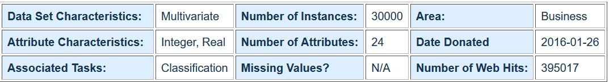
Overview of Dataset
The data sets deals with the data of customers default payments in which we need to compare the predictive accuracy of probability of default or not by using different Machine Learning Algorithms.
From the perspective of risk management, the result of predictive accuracy of the estimated probability of default will be more valuable than the binary result of classification - credible or not credible clients.
Dataset:
https://github.com/DevenderKumar090/ML1-PROJECT/blob/master/creditcard.csv

Slide 4
Overview of Dataset
Attribute Information:
Target Variable :
Default payment (Yes = 1, No = 0).
Explanatory Variables:
Limit Balance: Describes Credit Card limit balance.
Sex (1 = male; 2 = female).
Education (1 = graduate school; 2 = university; 3 = high school; 4 = others).
Marital status (1 = married; 2 = single; 3 = others).
Age (years).
Pay_0 to Pay_6 : History of past payment of subsequent Months .The measurement scale for the repayment status is: -1 = pay duly; 1 = payment delay for one month; ………9 = payment delay for nine months and above.
BILL_AMT(1 to 6): Amount of bill statement of particular Month.
PAY_AMT(1-6): Amount of previous payment.

Slide 5
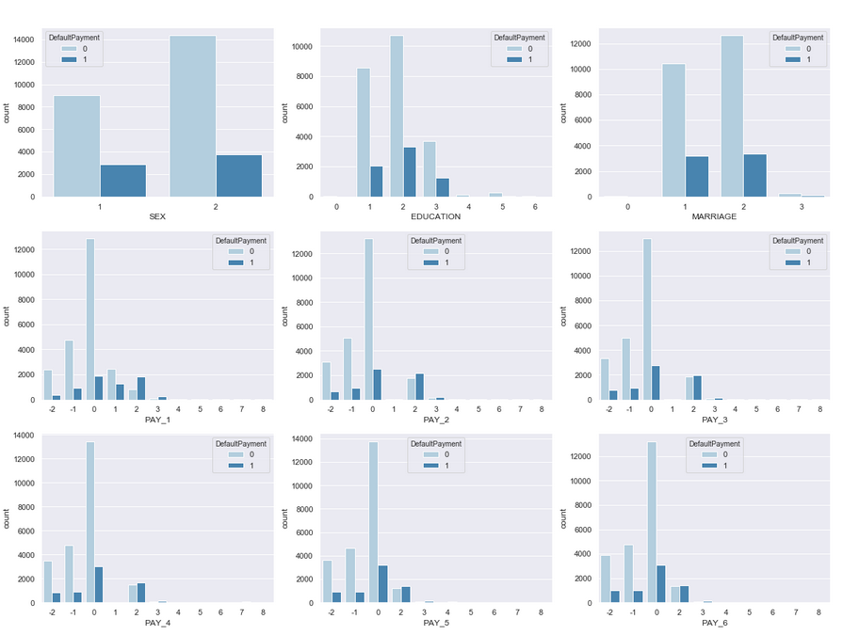
Exploratory Data Analysis
Plotting Histogram with Default Payments and Not according to the Explanatory Variables:

Slide 6
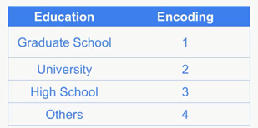
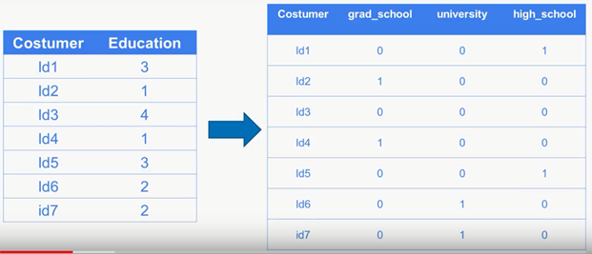
Dummy Features( one- Hot Encoding)
We perform One –Hot encoding on columns to make it either to 0 or 1 into a binary format .Like wise we applied for sex, education, marial status…etc.

Slide 7


Logistic Regression
Logistic Regression is one of the simplest algorithms which estimates the relationship between one dependent binary variable and independent variables, computing the probability of occurrence of an event.
After Finding the Result is as below:
The model has no power predicting default credit cards. However, it can be observed that the accuracy of the model is about 77%, which demonstrates that this metrics is not appropriate for the evaluation of this problem.

Slide 8

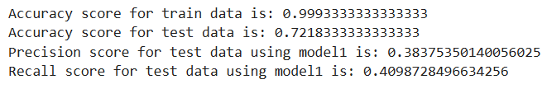
Decision Tree
Decision Trees are a type of Supervised Machine Learning (that is you explain what the input is and what the corresponding output is in the training data) where the data is continuously split according to a certain parameter. The tree can be explained by two entities, namely decision nodes and leaves.
After Findings the Result is as below:
The performance of the decision tree model improved compared to the logistic regression model showed previously. However, the Accuracy is still (0.72)

Slide 9

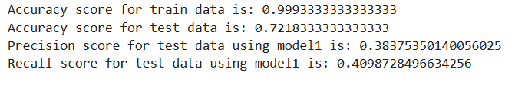
Decision Tree Using GridSearchCV
GridSearchCV lets you combine an estimator with a grid search preamble to tune hyper-parameters. The method picks the optimal parameter from the grid search and uses it with the estimator selected by the user. GridSearchCV inherits the methods from the classifier, so yes, you can use the .score, .predict, etc..
After Finding the Result is as below:
The performance of the decision tree model using GridSearchCV improved compared to the previous 2 models. Compared to Previous decision Tree model the True Positives and True Negatives Score has been increased.

Slide 10


Random Forest
In Random Forest, we grow multiple trees as opposed to a single tree in CART model .The forest chooses the classification having the most votes (over all the trees in the forest) and in case of regression, it takes the average of outputs by different trees.
We used Gini as criteria for both methods and result is as below:
Model 1-Default Parameters
Model 2-Tunning the Parameters

Slide 11
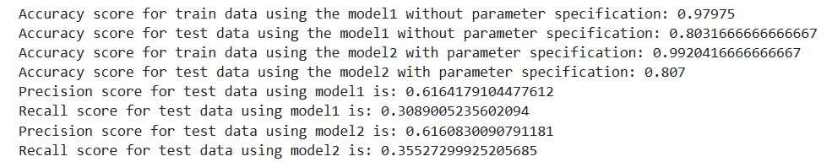
Random Forest
The performance of the Random Forest Model1 and Mode2 gives better accuracy compared to decision trees but Recall score is low (0.308 and 0.355)

Slide 12


Random Forest Using RandomizedSearchCV
A random search algorithm refers to an algorithm that incorporates some kind of randomness or probability (typically in the form of a pseudorandom number generator) in its methodology. The random element may be introduced through sampling specifications of the algorithm, or through noise in the function observation.
After Findings the Result is as below:
The performance of using Randomized Search model gives more accuracy but less recall score(0.34).

Slide 13
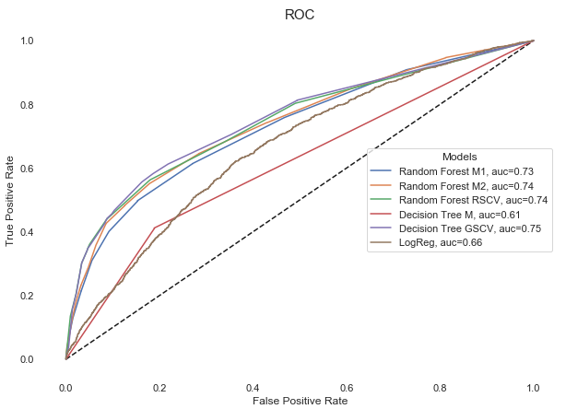
Plotting ROC Curve
Receiver Operating Characteristic (ROC) curve is a plot of the true positive rate against the false positive rate. The AUC is the Area Under Curve. If the AUC is high, the model is better distinguishing between positive and negative class.

Slide 14
Model Selection
The highest AUC is obtained for the Decision Tree GridSearchCV model, with a value of 0.75. This means there is 75% chance that the model will be able to distinguish between default class and non-default class.
Since it has the high AUC compared to others, so we select this Model.
Reference:
https://github.com/DevenderKumar090/ML1-PROJECT

Slide 15
Thank You

